Slide 1




Basic Presentation
Tvisha's Mission_Living with Purpose
Oct 2025- Child Cancer Awareness #CCA
Indus Science | Evita LLC

Slide 2
October Report #CCA
Activities Conducted
Fundraiser
Yellow out day
Social Media engagement
Public awareness speeches
Child Cancer Research
  Research paper written

Slide 3
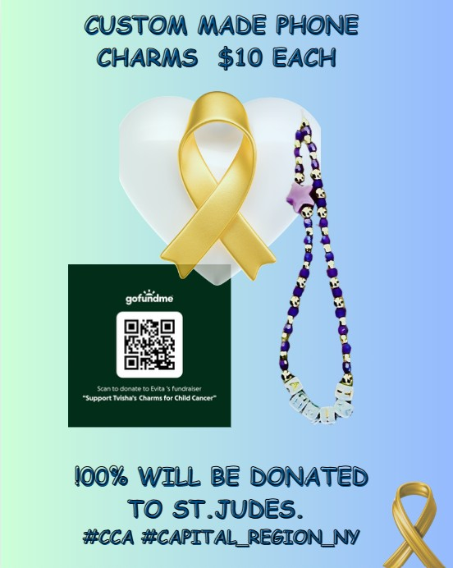
The Power of working together
The community came together to support the fundraiser and in a span of 2 weeks we could meet our targets, and by the end of the promised term the targets we exceeded.
28 charms were given out
Over 50 hours were dedicated to the cause.

Slide 4
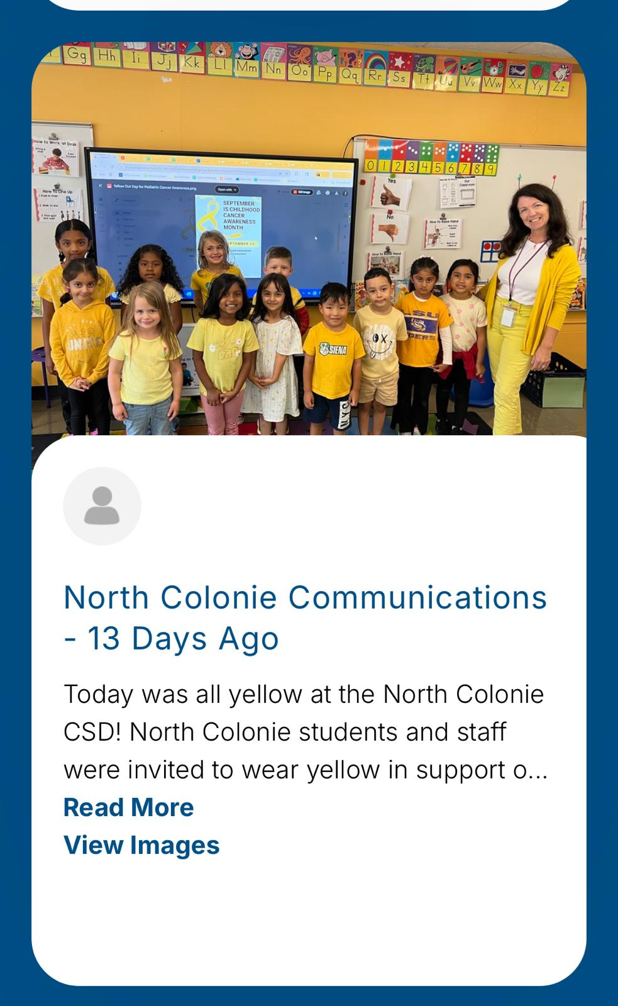

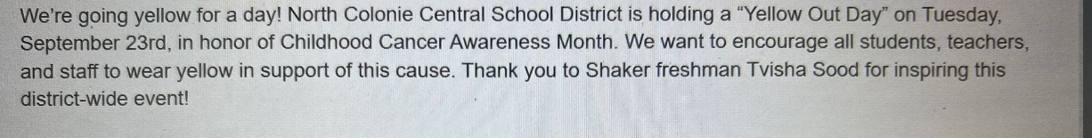
Spreading wings
The Whole of North Colonie School District participated in the yellow out day to spread awareness for Child Cancer Awareness.
Hope to be able to spread this campaign to a wider audience in the coming years.

Slide 5
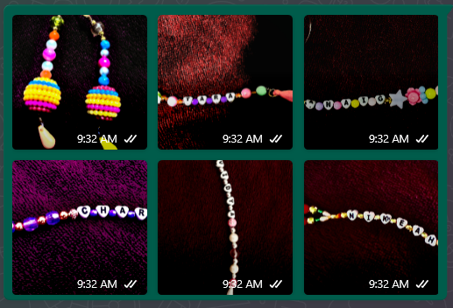
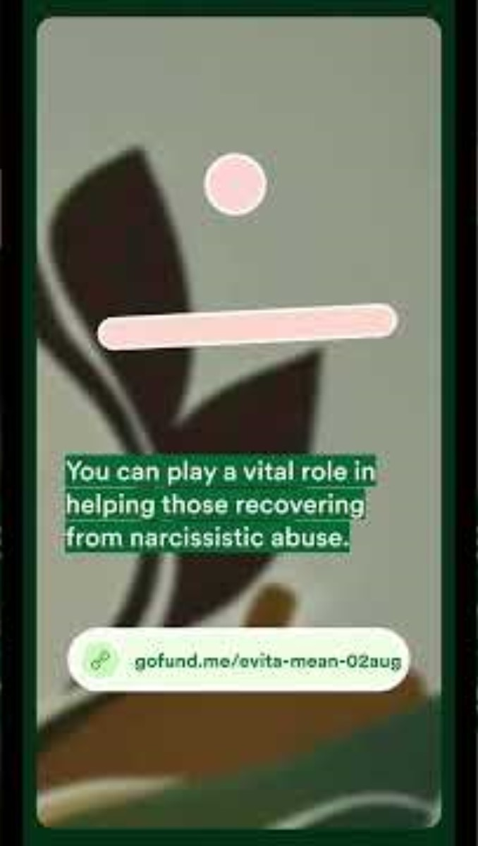
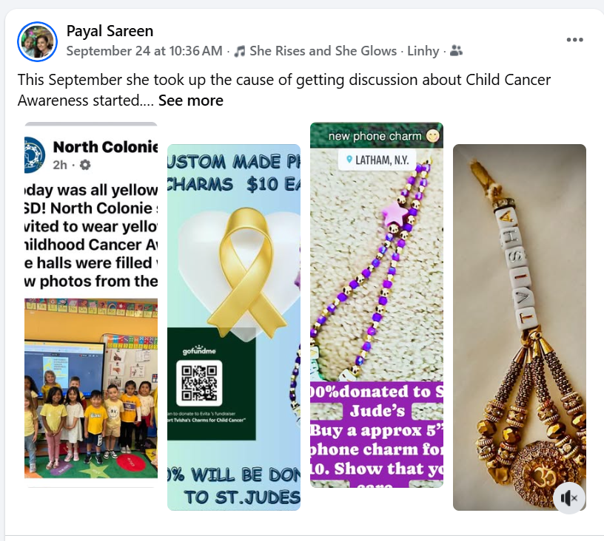
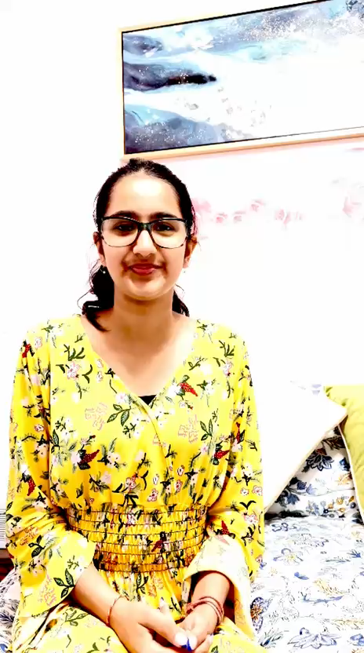
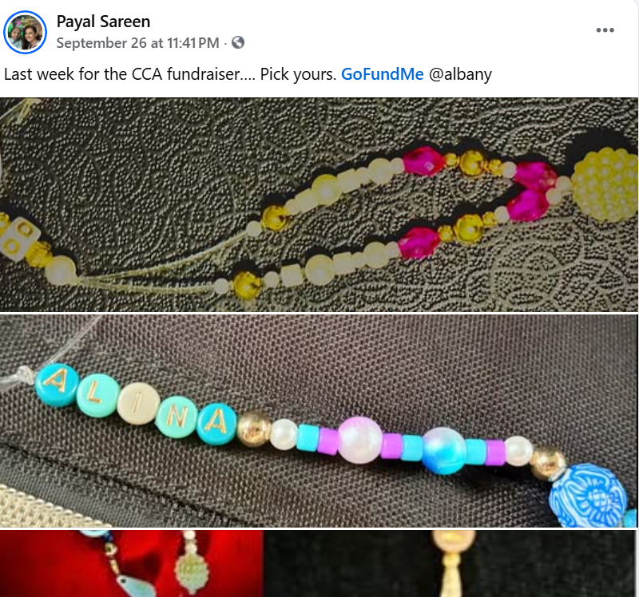
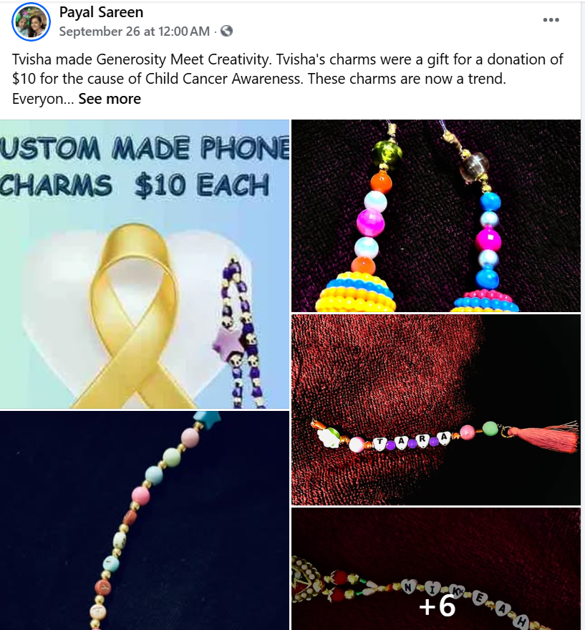
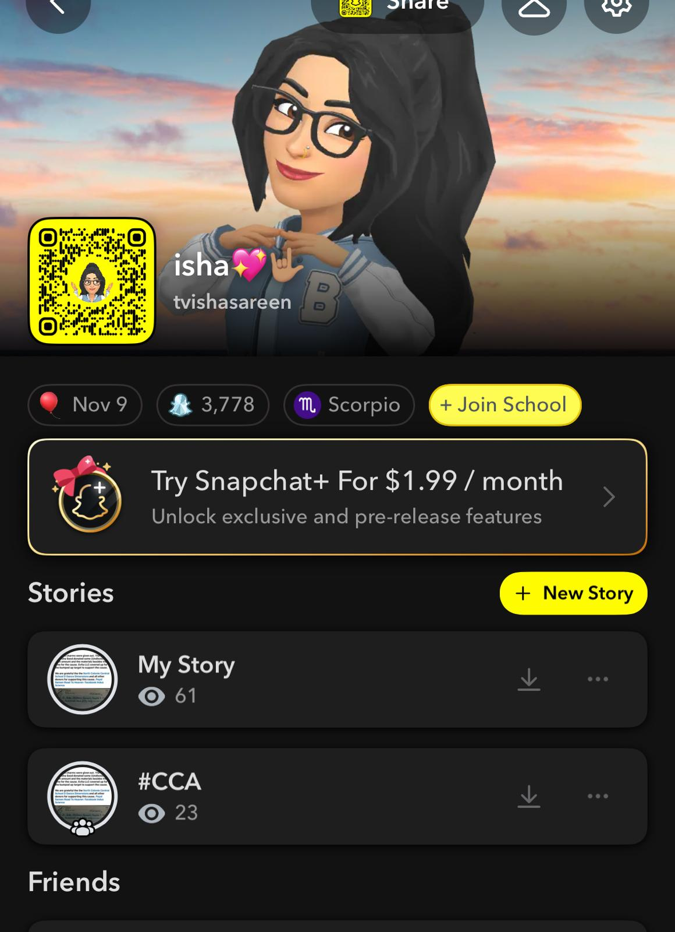
Engagement Via Social Media
Campaigns were run on Facebook, Instagram, threads, X, YouTube, Reels, Shots, Whatsapp, messages and email.
A gofundme page was created.
Evita LLC supported by promoting our cause on their website.
Contact Evita LLC

Slide 6
Public Speaking
Held gatherings at the local YMCA center
Spoke about the cause and campaign at the Dance dimensions studio at Albany
Another presentation to explain the types of pediatric cancer is scheduled for end of Oct. 2025
Contacted other community centers for opportunity to present the Child Cancer Types research performed during the month with the goal of educating the communities.
** Research work will be posted available @www.evitall.org Blog page by the end of October 2025 (Awaiting verification results)

Slide 7
Gratitude
North Colonie School District
Our friends at Dance Dimensions

